Slide 1


Slide 2
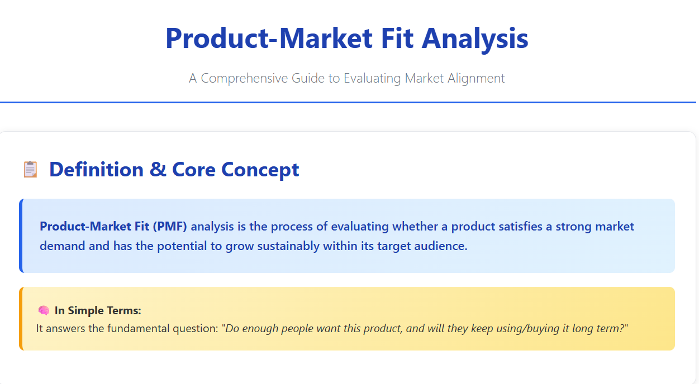

Slide 3
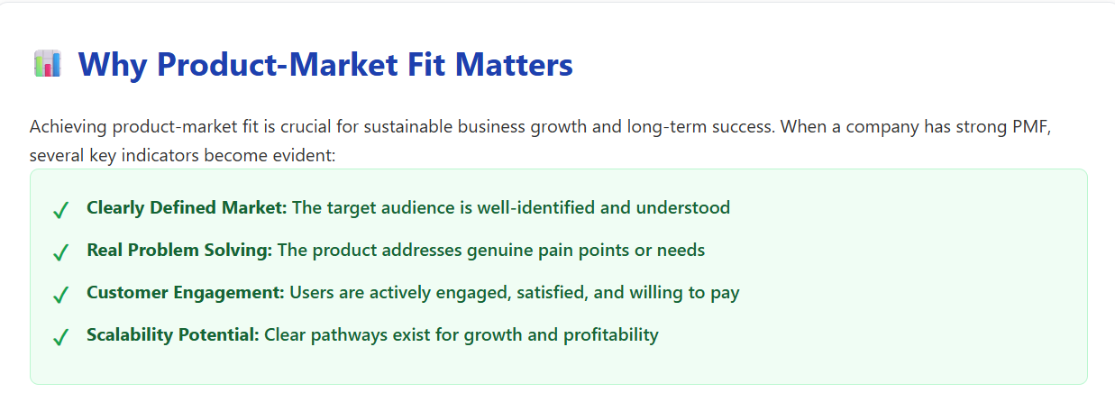

Slide 4
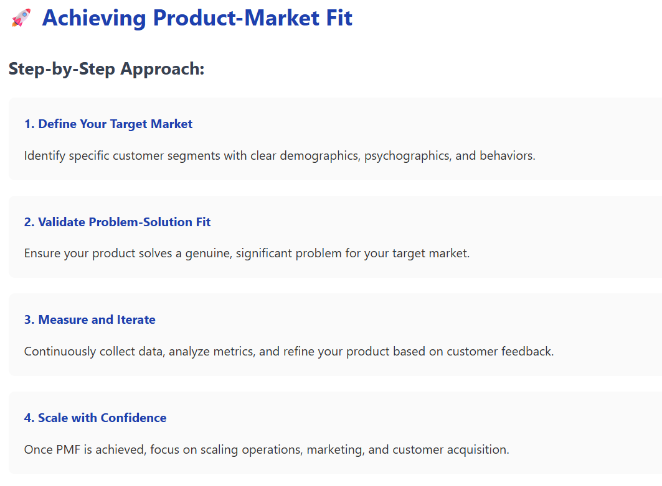

Slide 5
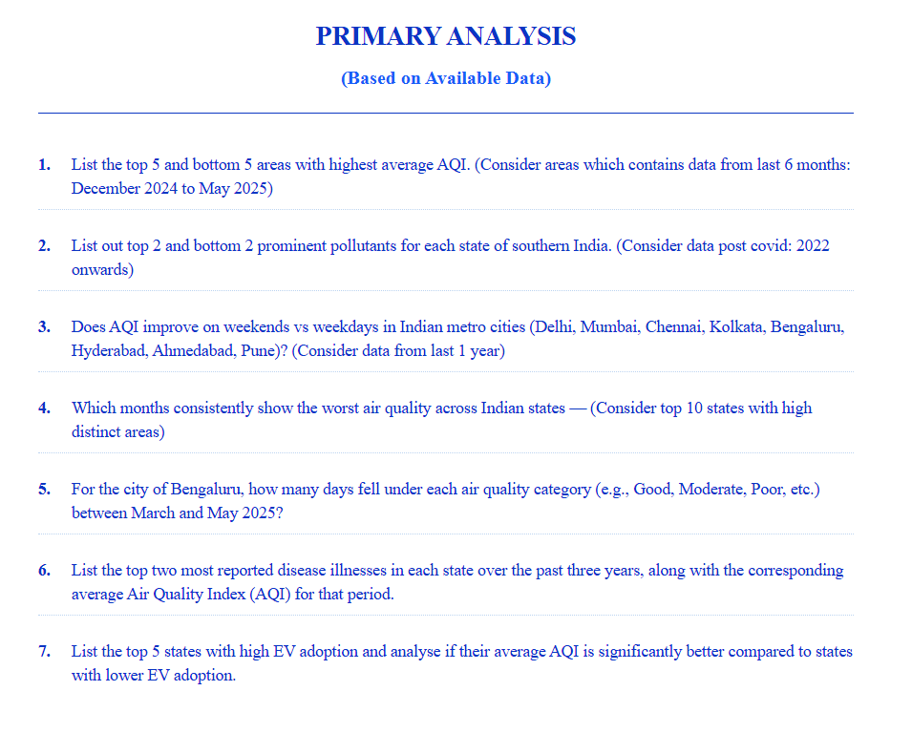

Slide 6
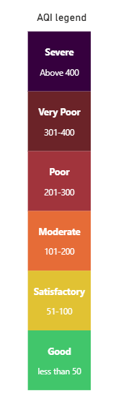
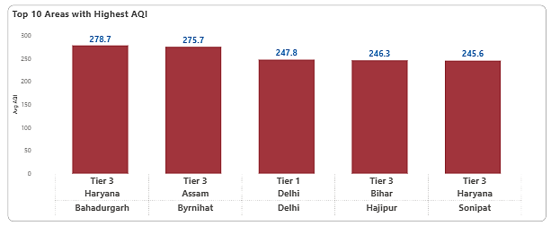
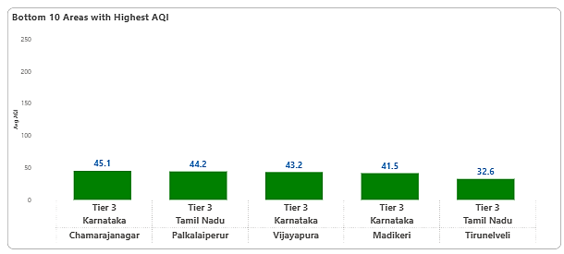
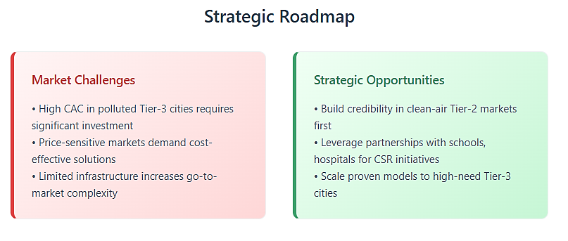
Air Quality Index Rankings: Top and Bottom Performing Areas
Last 6 months | Nov 2024- Apr 2025
Tier-3 cities present a dual opportunity: they dominate both high-pollution markets (requiring immediate solutions) and emerging clean-air markets (building long-term brand equity). This creates a strategic inflection point for market entry and expansion.

Slide 7
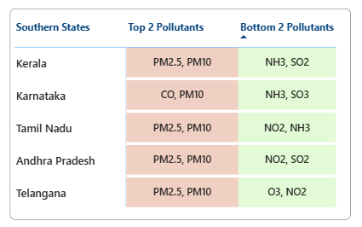
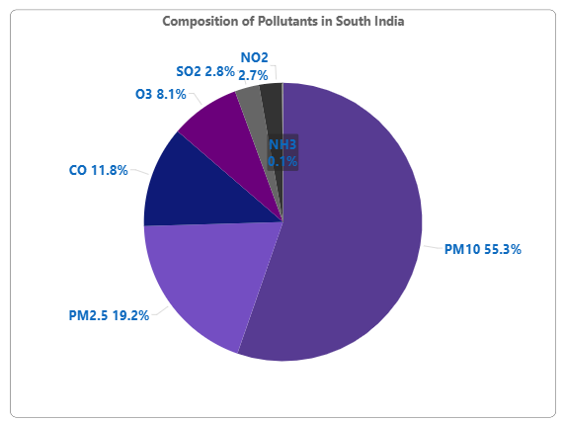
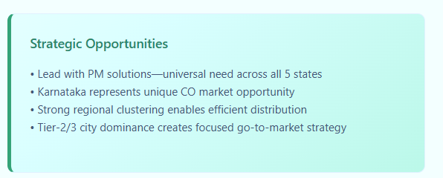
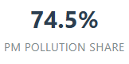
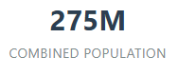
Key Pollutants Shaping Air Quality in Southern India
Apr 2022 – Apr 2025
Southern India presents a concentrated opportunity with PM2.5 and PM10 dominating 80% of pollution across all states. This creates a focused product strategy advantage—target particulate matter solutions first, then expand to gas-phase pollutants in specific state markets.

Slide 8
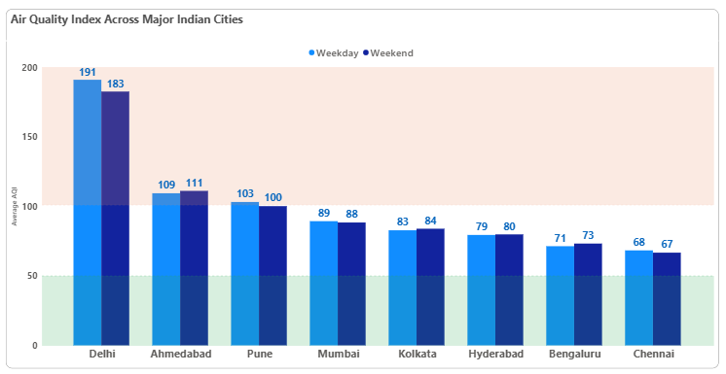
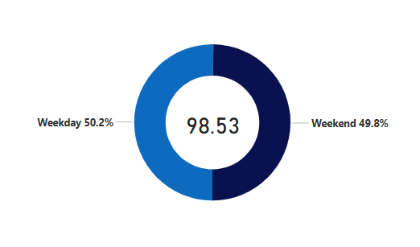
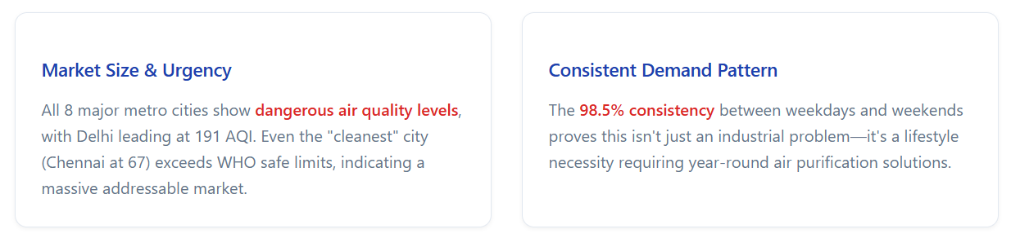
Weekdays and Weekends Show Similar Air Quality in India’s Metro Cities
Apr 2024 – Apr 2025
Air pollution remains a constant threat across India's major cities, with no significant improvement between weekdays and weekends. This indicates a structural problem requiring immediate intervention.

Slide 9
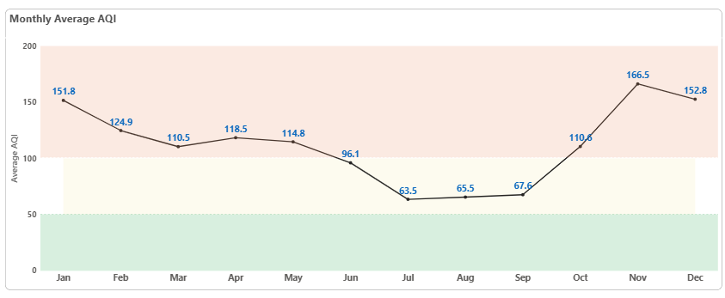
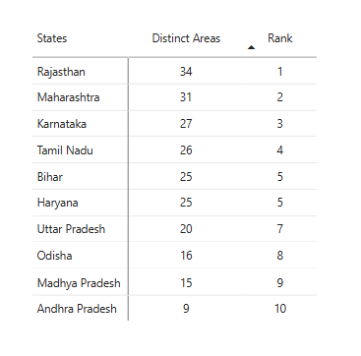
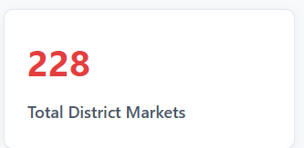
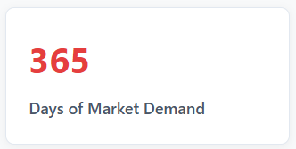
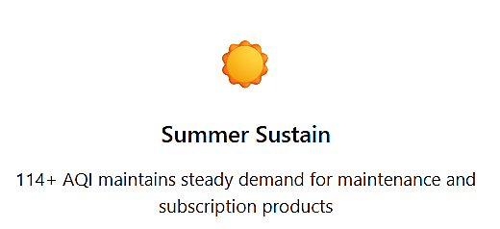
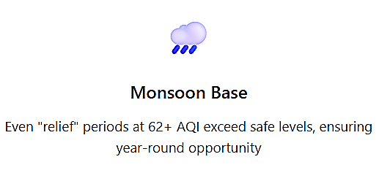
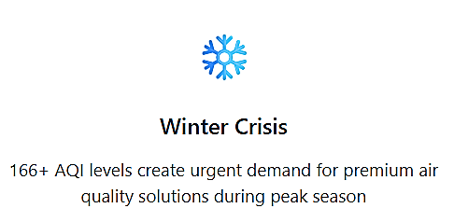
Seasonal AQI Trends Across India’s Top 10 States
India's Seasonal Air Quality Patterns Reveal Consistent Market Opportunity
Air quality crisis persists throughout the year with winter peaks reaching dangerous levels (166+ AQI) and even "cleaner" summer months exceeding safe thresholds. This creates a 12-month revenue opportunity across India's top 10 states.
Strategic Recommendation : While the top 10 states present consistent AQI challenges, demand is not evenly distributed. A city-level strategy combining AQI, PCI, and population reveals the most commercially viable zones.

Slide 10
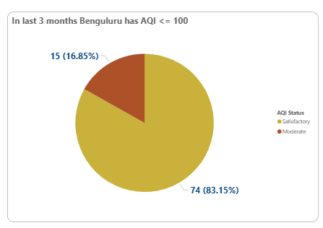
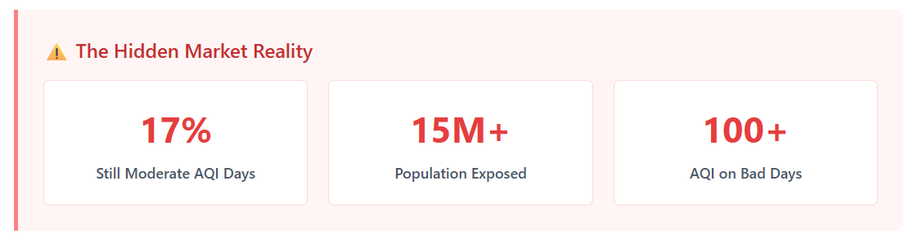
Bengaluru Air Quality Index
Market Intelligence • Feb-Apr 2025
With 83% of days recording satisfactory air, Bengaluru appears cleaner — yet moderate AQI days and exposure of 15M+ people reveal a subtle, underserved market for preventive air quality solutions.
83%
Days with satisfactory air
14M+
As of 2025, Bengaluru holds 10-12% of India’s Air purifier market - Ken research and Expert Market Share
Strategic Recommendations :
Position Air Purifiers as a Health & Lifestyle Product
Tap Into Affluent and Tech-Savvy Demographics
Promote Preventive Air Quality Awareness (about Indoor air exposure)

Slide 11
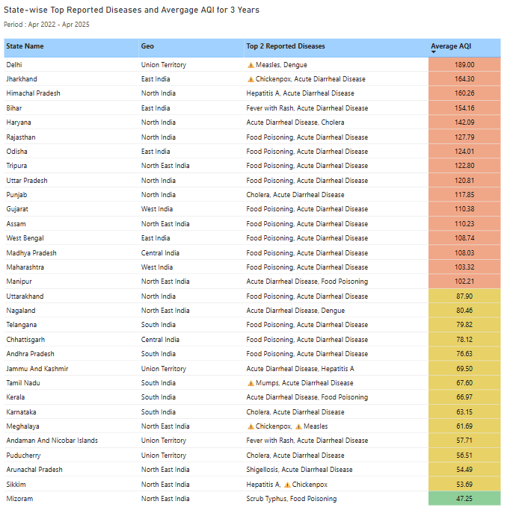
Air Quality & Health Impact Analysis
Data Source: Integrated Disease Surveillance Programme (IDSP), India | Period: Apr 2022 - Apr 2025
While AQI is a significant environmental and health metric, it does not directly align with major disease outbreaks across India.
🌧️ High AQI states → mostly water/food-borne diseases
🫁 Satisfactory AQI states → reported airborne diseases like Measles, Mumps, and Chickenpox, may because of environmental factors.
Moderate
Recommendation :
Air purifiers are most effective against airborne particulates and viruses—not food- or water-borne infections.
Strategy | Target States | Action
Target Respiratory Illness Zones | Tamil Nadu, Meghalaya, Delhi | Promote purifiers as respiratory health enhancers (HEPA + UV-C models).
Expand Beyond AQI Ratings | Pan-India | Emphasize risks like allergens, mold, and indoor air stagnation in urban and semi-urban homes.
Satisfactory
Good

Slide 12
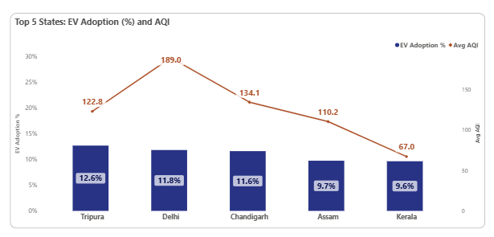
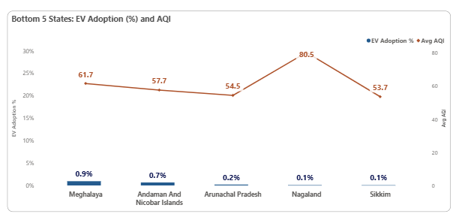
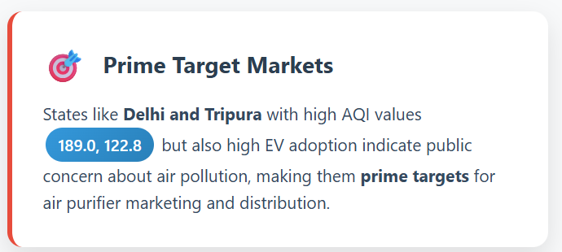
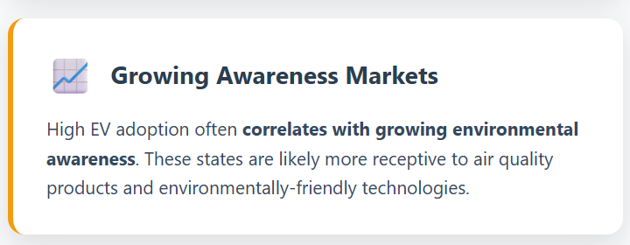
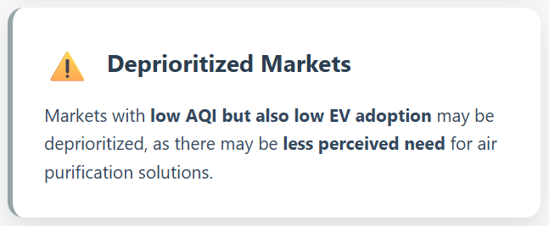
Strategic Market Priorities: Targeting High EV Adoption & Pollution States
Period: 2022-25
High EV adoption and severe air pollution in states like Delhi and Tripura signal both a need and a strong market for air purifiers. These regions are strategic priorities, as their environmentally conscious consumers are more likely to invest in air quality solutions.
Strategic Recommendations :

Slide 13
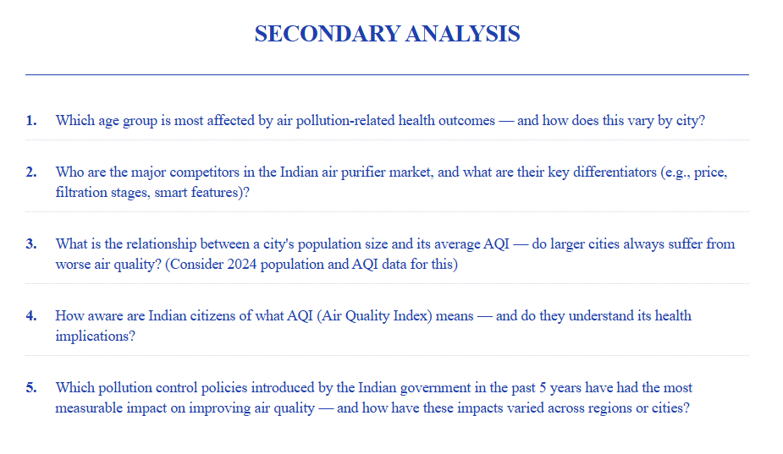

Slide 14
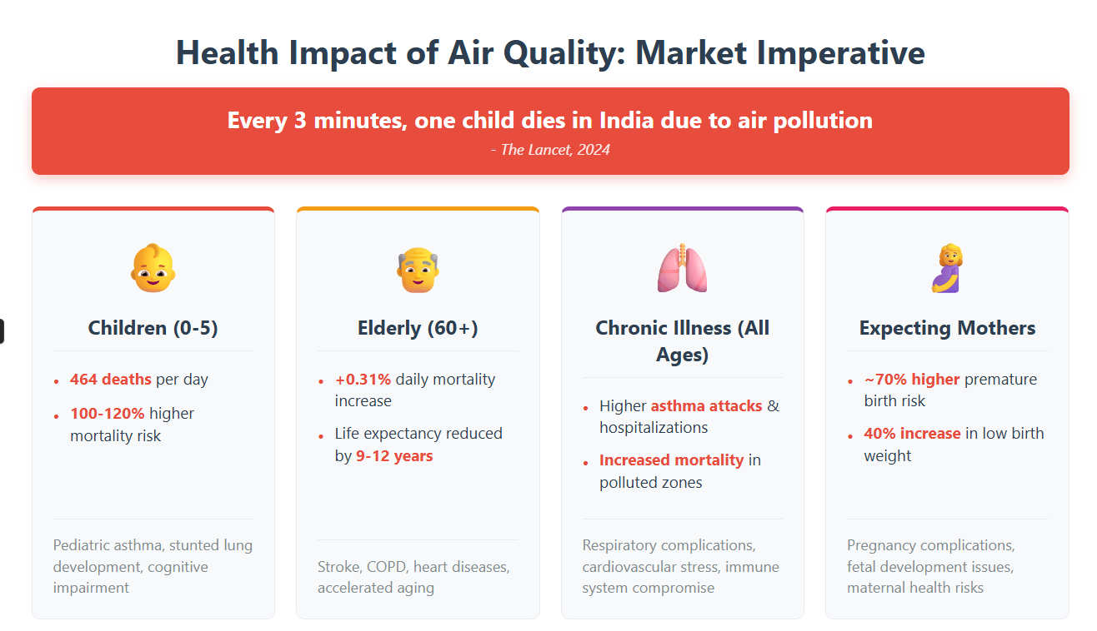

Slide 15
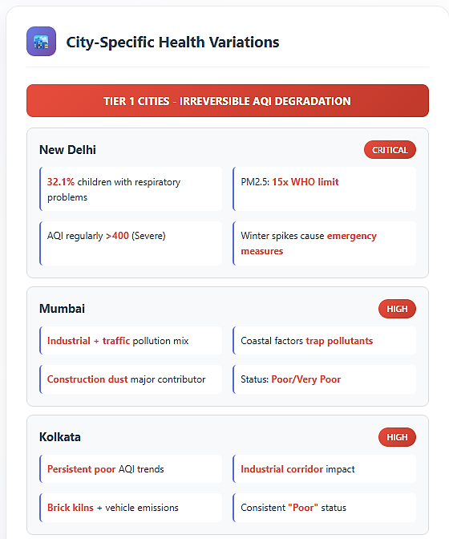
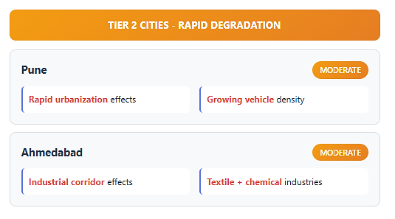
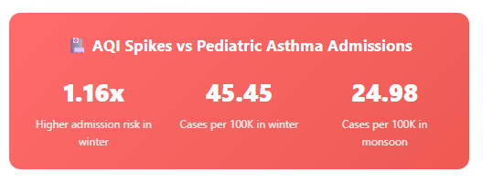
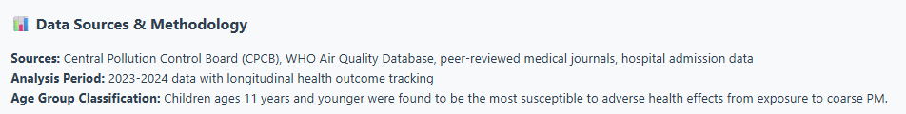
Health Impact in Cities

Slide 16
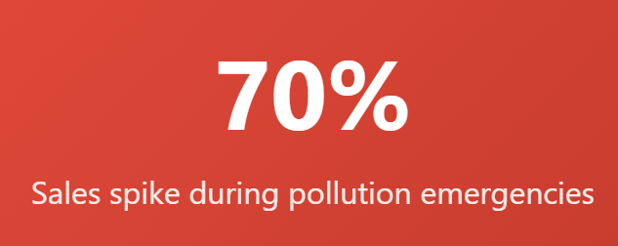
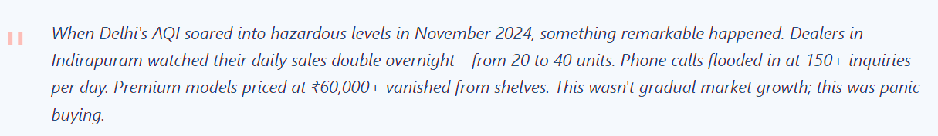
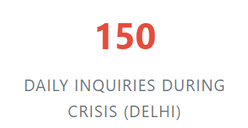
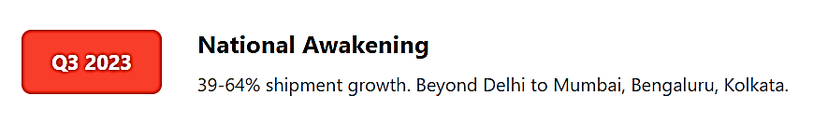
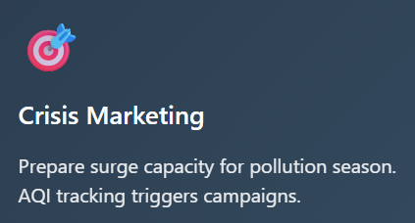
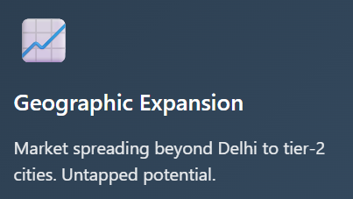
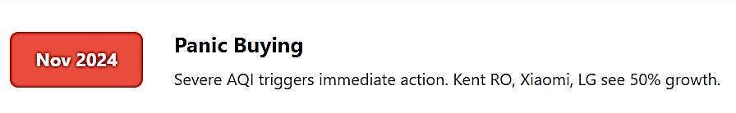
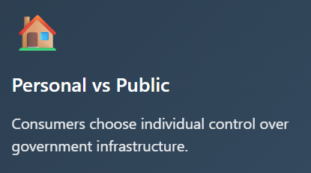
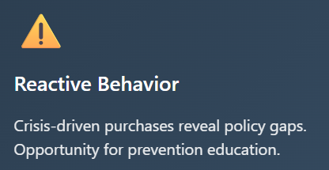
How Pollution Emergencies Are Reshaping India’s Air Purifier Market
Crisis-Driven Consumer Behavior
-The New Indian Express
Strategic Recommendations :
Philips led with ~53% market share, followed by Xiaomi and Dyson

Slide 17
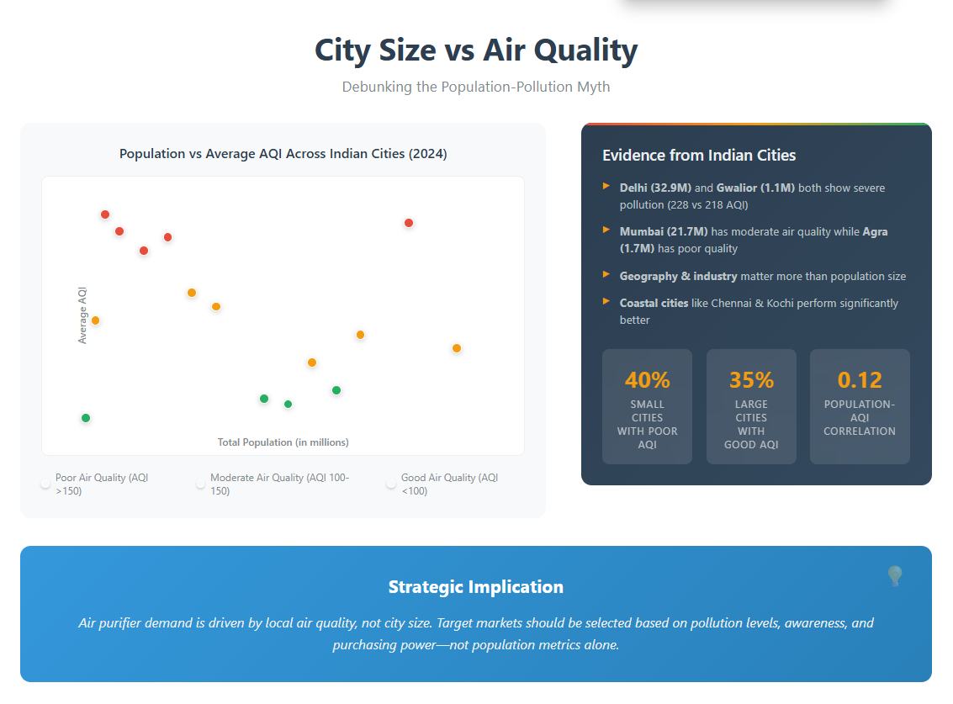
Gwalior
Delhi
Agra
Lucknow
Kanpur
Jaipur
Ahmedabad
Kolkata
Chandigarh
Hyderabad
Mumbai
Kochi
Bangalore
Pune
Chennai

Slide 18
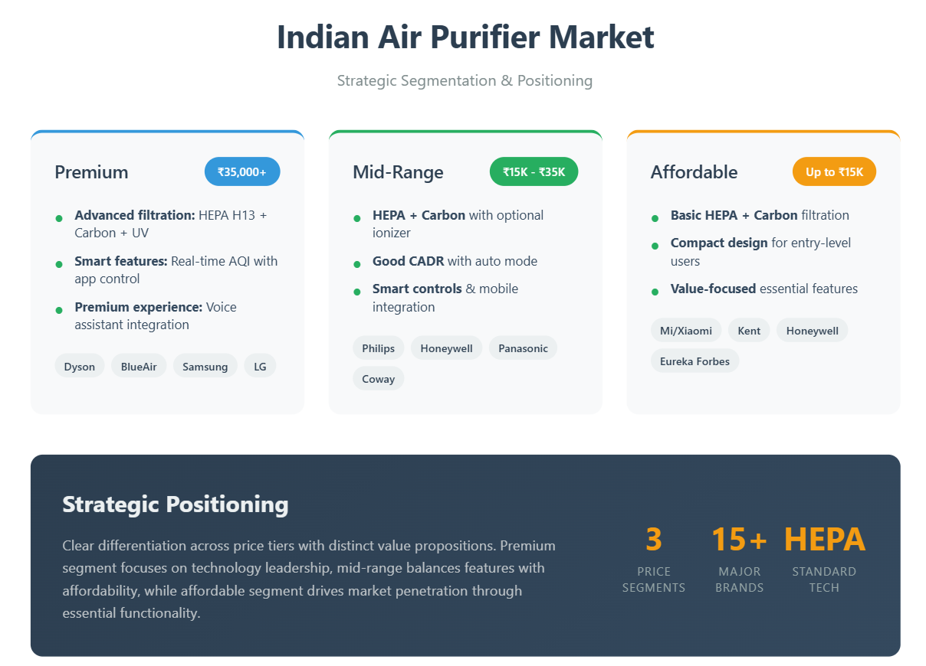

Slide 19
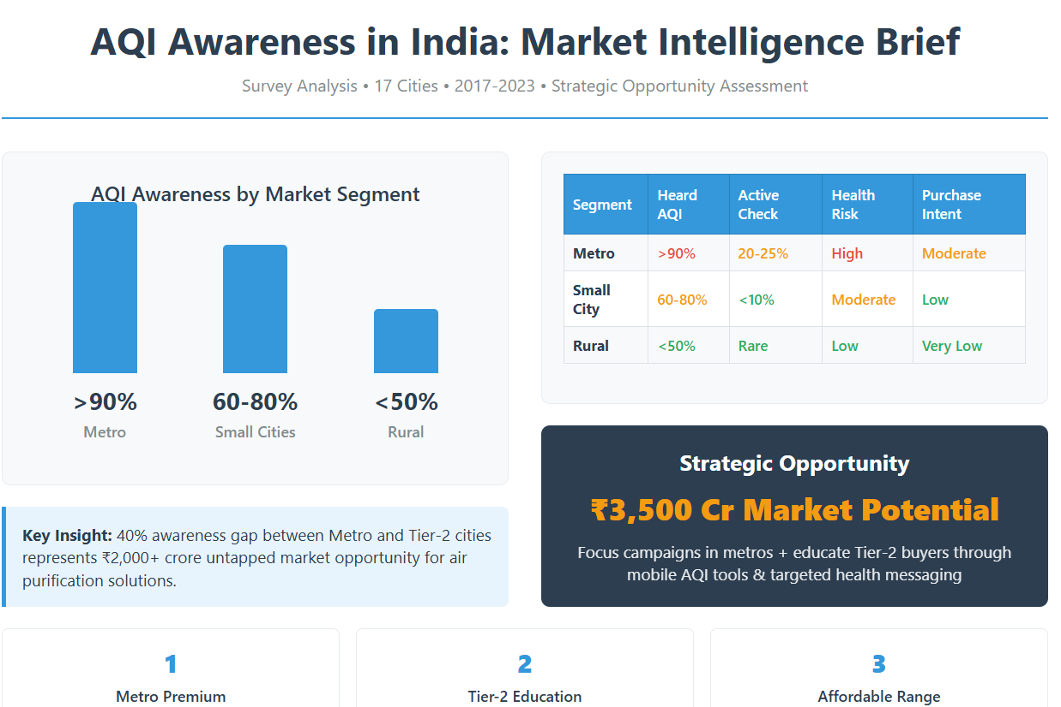

Slide 20
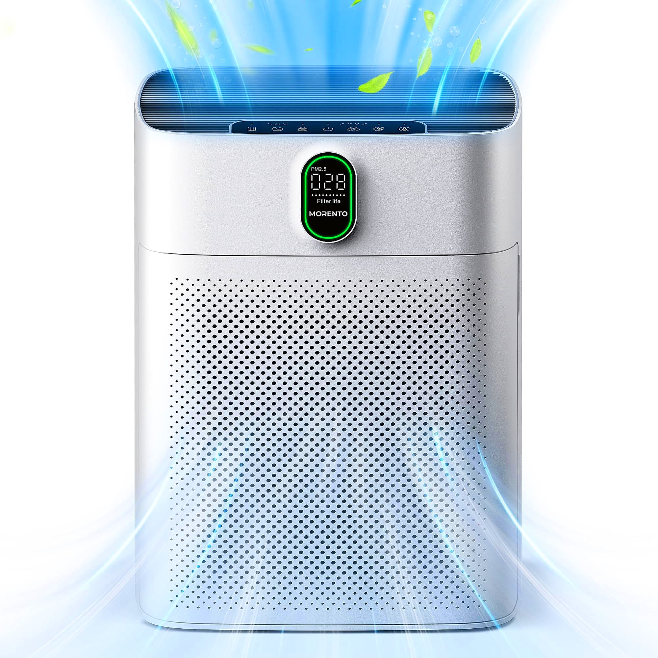
Product Requirements Document (PRD) for Air Purifier
Airpure Innovative
Product: Smart Air Purifier Prepared by: Punam Godugula
Date: August 2025
Target Launch: [Q1 2026 or TBD] Version: 1.0
Required Filter Features
Feature | Description | Justification
PM2.5 Sensor | Real-time detection of fine particulate matter (≤2.5 microns). | Critical for health and AQI display.
VOC Sensor | Detects volatile organic compounds (e.g., benzene, formaldehyde). | Essential for identifying and eliminating toxic chemical compounds in indoor air.
HEPA H13 Filter | High-efficiency filtration system for allergens, pollen, dust. | Medical-grade filtration ensuring 99.97% removal of particles 0.3 microns and larger.
Activated Carbon Filter | Specialized carbon filtration system that absorbs odors, gases, and volatile organic compounds effectively. | Improves indoor air quality and comfort.

Slide 21

Air Purifier Features
Feature | Description | Justification
AQI Display (LED/Screen) | Real-time Air Quality Index display on device. | Increases awareness and perceived value..
Auto Mode | Automatically adjusts fan speed based on air quality. | Energy saving and ease of use..
Mobile App Integration | Control purifier via app, receive AQI notifications. | Enhances user convenience and smart home compatibility.
Child Lock | Prevents accidental settings changes. | Safety feature for homes with children.
Sleep Mode | Ultra-quiet operation with dimmed lights. | Supports uninterrupted sleep-in bedrooms.

Slide 22
Feature Gap Matrix
Gap Area | Description of Missing Feature | Customer Pain Point
Smart AQI Syncing | Many products don’t auto-sync with real-time local outdoor AQI or integrate well with apps | Users can't compare indoor vs. outdoor quality; no contextual control.
Compact & Aesthetic Designs | Many purifiers are bulky, industrial-looking, or don’t blend well into modern interiors. | Consumers want sleek, space-saving devices for urban homes.
Lack of Multi-Language UI/App | Most apps/devices only support English.. | Users from Tier 2/3 cities feel excluded.
No-Tier Based Subscription or Filter Alert Model | Most brands don't have proactive filter subscription alerts or auto-replacement options. | Users forget to replace filters, reducing effectiveness.

Slide 23

Tiered Pricing Models for Target Segments

Slide 24

India's Air Purifier Market Projection 2025-2034
Market size reached INR 777.75 Crore in 2024.
16.3 %
Compound Annual Growth Rate(CAGR)
₹ 3,521 cr
Projected Market Value
Source :
expertmarketresearch

Slide 25


National Progress: India saw a 26.8% reduction in average particulate matter (PM10/PM2.5) levels nationwide from 2019 to 2024; NCAP cities averaged a 24.5% reduction attributed to targeted interventions

Slide 26



